Slide 1
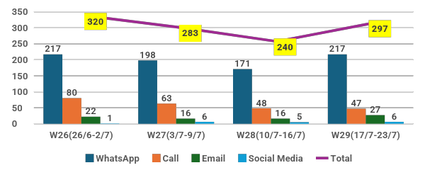
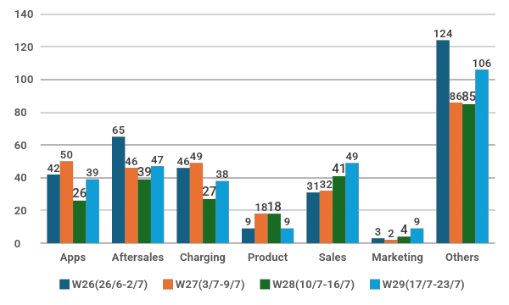
PeC Inquiry / Analysis & Key Highlights : 17 July – 23 July 2026
Breakdown of Total Inquiries by Channel
Week-over-week change vs 10/7-16/7
Sales 49, ↑20%
Aftersales 47, ↑21%
Apps 39, ↑50%
Charging 26, ↑41%
Product 9, ↓ 50%
Marketing 9, ↑125%
Others 85, ↑25%
Division / Concern | e.MAS5 | e.MAS7 | e.MAS7 PHEV | NA | Grand Total
Sales | 24 | 8 |  | 17 | 49
Accessories | 11 |  |  | 6 | 17
Tonneau Cover Installation |  |  |  | 1 | 1
Tonneau Cover Stock |  |  |  | 1 | 1
3-Pin Plug | 11 |  |  | 4 | 15
Booking | 3 |  |  | 4 | 7
Cancellation | 1 |  |  | 1 | 2
Information |  |  |  | 2 | 2
Status | 2 |  |  | 1 | 3
Custom EV Plate (Frame) | 1 | 1 |  |  | 2
Promotion (Raya / Corporate Rebate) | 2 | 1 |  |  | 3
Test Drive |  | 1 |  |  | 1
Transfer Ownership | 1 | 2 |  | 1 | 4
Vehicle Delivery | 4 | 1 |  | 2 | 7
Vehicle Details | 2 | 2 |  | 4 | 8
Colour | 1 |  |  |  | 1
Price | 1 |  |  |  | 1
Stock Availability |  | 2 |  | 4 | 6
Total Inquiries: 297
Week-over-week change vs 10/7-16/7: ↑24%
The majority of inquiries came through WhatsApp (73%), Phone Calls (16%)
The remaining of inquiries came from Email (9%) & Social Media (2%).
Breakdown of Total Inquiries by Case Division

Slide 2
Inquiry / Analysis & Key Highlights : 17 July – 23 July 2026
Division / Concern | e.MAS5 | e.MAS7 | e.MAS7 PHEV | NA | Grand Total
After Sales | 13 | 28 |  | 6 | 47
Roadside Assistance | 4 | 5 |  |  | 9
Request for RSA Contact |  | 1 |  |  | 1
RSA Escalation | 4 | 4 |  |  | 8
Service / Recall Campaign |  | 2 |  |  | 2
Information |  | 2 |  |  | 2
Service Operation | 5 | 12 |  | 4 | 21
Courtesy Car | 1 |  |  |  | 1
Regular Maintenance Service Time | 1 | 2 |  | 1 | 4
Service Appointment | 1 | 4 |  |  | 5
Service Center Outlet / Location | 2 | 2 |  | 1 | 5
Service Maintenance |  | 3 |  |  | 3
Vehicle Repair / Service Status |  | 1 |  | 2 | 3
Spare Part |  | 2 |  |  | 2
Parts Information |  | 2 |  |  | 2
User Manual | 2 | 6 |  | 1 | 9
Car Features | 2 | 2 |  | 1 | 5
Obtain User Manual |  | 4 |  |  | 4
Warranty | 2 | 1 |  | 1 | 4
Warranty Coverage | 1 | 1 |  | 1 | 3
Warranty Information | 1 |  |  |  | 1

Slide 3
Inquiry / Analysis & Key Highlights : 17 July – 23 July 2026
Division / Concern | e.MAS5 | e.MAS7 | e.MAS7 PHEV | NA | Grand Total
Apps | 10 | 17 |  | 12 | 39
Information | 10 | 13 |  | 11 | 34
Change Phone Number | 4 | 6 |  | 2 | 12
Multiple Device Login |  |  |  | 1 | 1
Profile Reactivation | 2 |  |  |  | 2
Vehicle Linking | 3 | 1 |  | 2 | 6
Vehicle Live Location | 1 | 6 |  | 6 | 13
Operation |  | 2 |  |  | 2
Data Balance Information |  | 2 |  |  | 2
User ID |  | 2 |  | 1 | 3
Information |  | 2 |  | 1 | 3
Division / Concern | e.MAS5 | e.MAS7 | e.MAS7 PHEV | NA | Grand Total
Charging | 10 | 11 | 2 | 15 | 38
Home Charging | 9 | 9 | 2 | 11 | 31
Assessment | 6 | 8 | 1 | 8 | 23
Installation | 2 | 1 | 1 | 1 | 5
Wallbox Purchase |  |  |  | 1 | 1
Warranty | 1 |  |  | 1 | 2
Public Charging | 1 | 2 |  | 4 | 7
Charging Procedure |  |  |  | 2 | 2
Pre-Authorization | 1 | 1 |  |  | 2
Promotion |  | 1 |  |  | 1
Billing |  |  |  | 2 | 2

Slide 4
Inquiry / Analysis & Key Highlights : 17 July – 23 July 2026
Division / Concern | e.MAS5 | e.MAS7 | e.MAS7 PHEV | NA | Grand Total
Product | 4 | 4 |  | 1 | 9
Infotainment | 4 | 4 |  | 1 | 9
Data Information | 1 | 2 |  |  | 3
Software Updates | 1 | 1 |  |  | 2
Vehicle Settings | 2 | 1 |  | 1 | 4
Division / Concern | e.MAS5 | e.MAS7 | e.MAS7 PHEV | NA | Grand Total
Marketing |  |  |  | 9 | 9
Event/Campaign |  |  |  | 2 | 2
Partnership / Collaboration |  |  |  | 2 | 2
Proposal |  |  |  | 4 | 4
Sponsorship |  |  |  | 1 | 1

Slide 5
Proton e.MAS RSA case : 17 July – 23 July 2026
Vehicle Model | Incident Date | Vehicle No. | Cause of Breakdown | Purchased From | Breakdown Location | Arrived Location | Remarks
e.MAS7 Premium | 17 Jul 2026 | MED7756 | Flat tire | Proton e.MAS Muar - Mayang Holdings | Muar Custom Kitchen Cabinet, Johor | Proton e.MAS Muar - Mayang Holdings | Towed to service center for tire repair
e.MAS5 Prime | 17 Jul 2026 | QS6426X | Accident | Proton e.MAS Bintulu - Supernau Motors Trading | Kuching - Saujana Bus Terminal, Sarawak | Proton e.MAS Kuching - Ghee Hua Co. | Towed to B&P Service Centre for vehicle repair
e.MAS7 PHEV Premium Plus | 17 Jul 2026 | PSG3004 | Unable to start | Proton e.MAS Alor Setar - Rahmat Jutamas | Kampung Alor Setar, Kedah​ | Proton e.MAS Alor Setar - Rahmat Jutamas | Towed to service center for vehicle inspection
e.MAS5 Premium | 17 Jul 2026 | VQE9 | Unable to start | Proton e.MAS Kuala Terengganu - IndahSari NEV | McDonald’s Pantai Batu Buruk DT, Terengganu | Proton e.MAS Melaka - NHL Auto Tech | Towed to service center for vehicle inspection
e.MAS5 Premium | 18 Jul 2026 | VRA4249 | Flat tire | Proton e.MAS Seri Kembangan - AJG Mobility | Highway PLUS, Arah Selatan, Labu, Negeri Sembilan | Proton e.MAS Seremban - KKT New Energy | Towed to service center for tire repair
e.MAS5 Premium | 18 Jul 2026 | EV1036 | Accident | Proton e.MAS Kuantan - HK Electra | Hot & Spicy Burger, Kuantan, Pahang | Proton e.MAS Kuantan - HK Electra (B&P) | Towed to B&P Service Centre for vehicle repair
e.MAS7 PHEV Premium Plus | 18 Jul 2026 | VIPS7920 | Flat tire | Proton e.MAS Shah Alam - SG Car | Highway Utara-Selatan, Arah Utara, Yong Peng, Johor | Toyo Tires Senawang, Negeri Sembilan | Towed to tire shop for tire repair
e.MAS5 Premium | 19 Jul 2026 | JYU2121 | Accident | Proton e.MAS Putrajaya - Jewel Sonic | Plaza Tol Sunway (KESAS), Subang Jaya, Selangor | Proton e.MAS Putrajaya - Jewel Sonic | Towed to service center for vehicle repair
e.MAS7 Premium | 19 Jul 2026 | UC2990 | Flat battery | Proton e.MAS Petaling Jaya - Regal Motors EV | Plaza Tol Simpang Renggam, Johor | Petronas Bandar Baru Ayer Hitam, Johor | Towed to charging station for vehicle charging
e.MAS7 Premium | 20 Jul 2026 | QRD1515 | Flat tire | Proton e.MAS Bintulu - Supernau Motors Trading | Bintulu, Sarawak | G23 Auto Tyres & Wheels, Sarawak | Towed to tire shop for tire repair

Slide 6
Proton e.MAS RSA case : 17 July – 23 July 2026
Vehicle Model | Incident Date | Vehicle No. | Cause of Breakdown | Purchased From | Breakdown Location | Arrived Location | Remarks
e.MAS7 Premium | 20 Jul 2026 | DEJ200 | Flat tire | Proton e.MAS Tampoi - Promas EV | Iskandar Puteri, Johor | Tyre Shop Nabila Shabaz, Gelang Patah, Johor | Towed to tire shop for tire repair
e.MAS7 PHEV Premium Plus | 21 Jul 2026 | SMV291 | Accident | Proton e.MAS Balakong - Jawira | Kedai Makan Selera Kubang Panjang, Triang, Pahang | Proton e.MAS Subang Jaya – MBf EV Auto (B&P) | Towed to B&P Service Centre for vehicle repair
e.MAS7 Premium | 21 Jul 2026 | EV7003 | Accident | Proton e.MAS Kota Bharu - JM Otomobil (EV) | Tunjang Trading, Kota Bharu, Kelantan | Proton e.MAS Kuantan - HK Electra (B&P) | Towed to B&P Service Centre for vehicle repair
e.MAS5 Prime | 21 Jul 2026 | SJQ2924 | Accident | Proton e.MAS Kota Kinabalu - Harapan Maju | Putatan, Sabah | Proton e.MAS Kota Kinabalu - Fook Loi Eurocar | Towed to service center for vehicle repair
e.MAS5 Premium | 22 Jul 2026 | NEJ776 | Flat tire | Proton e.MAS Setia Alam - Wheelcorp EV | Port Klang, Selangor | Continental Top Hill Auto Service, Shah Alam | Towed to tire shop for tire repair
e.MAS7 Premium | 22 Jul 2026 | VQF8426 | Accident | Proton e.MAS Klang, Jalan Kapar - Dimensi World | My Rumah Imperio Home, Alor Setar, Kedah | Proton e.MAS Alor Setar - Rahmat Jutamas | Towed to Service Centre for vehicle repair
e.MAS7 Premium | 22 Jul 2026 | VQF8426 | Accident | Proton e.MAS Klang, Jalan Kapar - Dimensi World | Alor Setar, Kedah | Proton e.MAS Subang Jaya – MBf EV Auto (B&P) | Towed to B&P Service Centre for vehicle repair
e.MAS7 Premium | 23 Jul 2026 | VPV4734 | Flat battery | Proton e.MAS Setapak - Igreen Premium | MRR2, Ampang, Selangor | JomCharge Charging Station, Segambut KL | Towed to charging station for vehicle charging
e.MAS7 Premium | 23 Jul 2026 | FH5105 | Flat tire | Proton e.MAS Shah Alam - SG Car | Petron NKVE KL Bound, Shah Alam, Selangor | TUHU Car Care – Glenmarie, Selangor | Towed to tire shop for tire repair
e.MAS5 Prime | 23 Jul 2026 | APE8321 | Accident | Proton e.MAS Jalan Tun Razak - MBf EV Auto | CHAGEE Anggun City, Rawang, Selangor | Proton e.MAS Setapak - Igreen Premium | Towed to service centre for vehicle repair

Slide 7
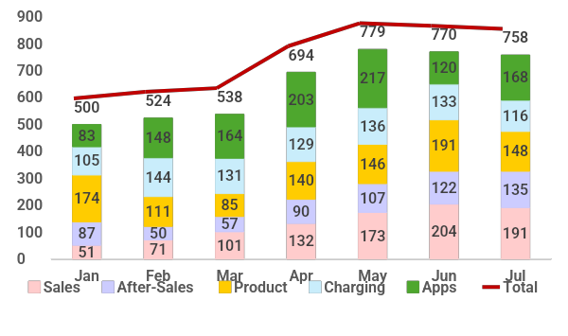
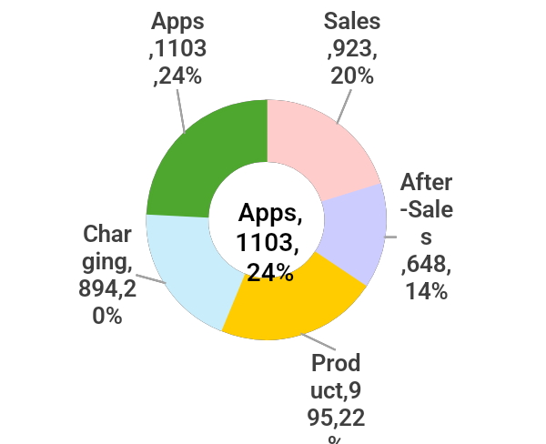
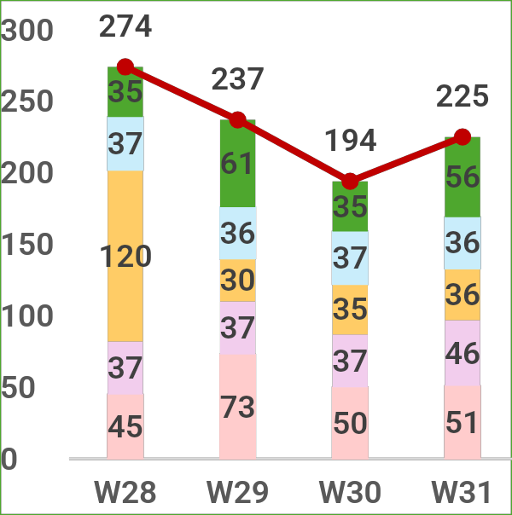
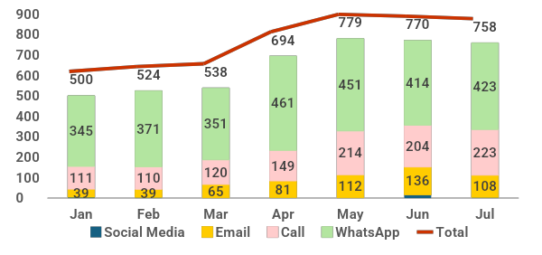
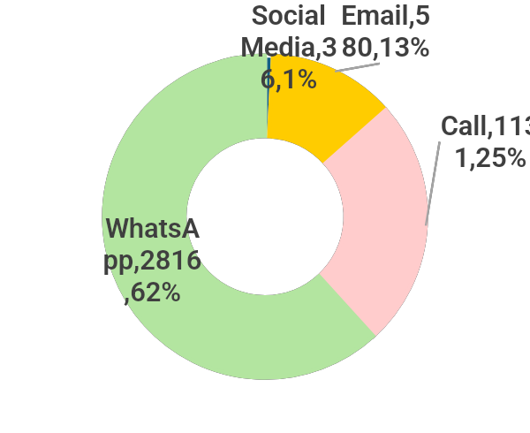
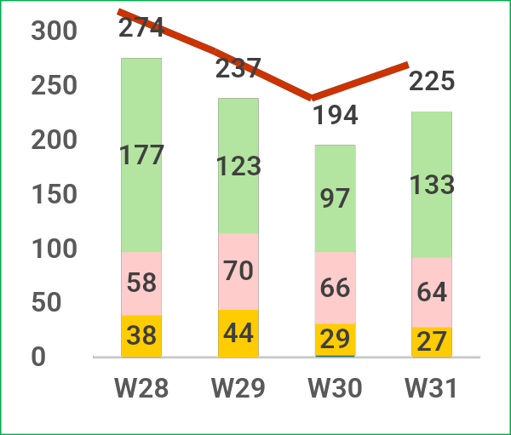
PeC Complaint / Analysis & Key Highlights W31 : 17 July – 23 July 2026
1
Total Customer Complaint on W31 (17 July - 23 July 2026) : 225 cases
Highest complain received on W31 (17 July – 23 July 2026) : Apps with 56 cases , 25%
Total Case registered as of 23 July 2026 are 4,563 cases [App : 1,103 cases , Product : 995 cases, Sales: 923 cases , Charging : 894 cases, Aftersales : 648 cases]
Total Customer Complaint: 01.01.2026 – 23.07.2026
YTD (as of 23.07.26)
Complain by Division
Total Case Division on W31
Apps | 56
Sales | 51
Aftersales | 46
Product | 36
Charging | 36
Total Complaint | 225
(W4 Of July)
2
YTD 2026 (as at 23.07.2026) : 62% of the complaint registered by Whatsapp
YTD (as of 23.07.26)
Complain by Channel
Complaint By Channel: 01.01.2026 – 23.07.2026
Total Source on W31
WhatsApp | 133
Call | 64
Email | 27
Social Media | 1
Total Source | 225
WhatsApp
2816
62%
(W4 Of July)

Slide 8
Complaint / Analysis & Key Highlights W31 : 17 July – 23 July 2026
Division / Concern | e.MAS5 | e.MAS7 | e.MAS7 PHEV | NA | Grand Total
After Sales | 11 | 28 |  | 7 | 46
Airbag error message |  |  |  | 1 | 1
Airconditioner Faulty |  | 1 |  |  | 1
Body |  | 7 |  | 2 | 9
Exterior (Tail lamp, door, mudguard, bottom cover, rear wheel) |  | 5 |  | 1 | 6
Interior (Seat defect) |  | 2 |  | 1 | 3
Brake / Electronic Parking Brake | 1 | 1 |  |  | 2
Noise | 1 |  |  |  | 1
Emergency brake warning |  | 1 |  |  | 1
Electrical | 2 | 3 |  |  | 5
Improper Function (Audio Output, VR AI voice, Vehicle Alarm, Vehicle Light Signal) | 2 | 3 |  |  | 5
Features | 2 | 3 |  | 3 | 8
Improper Function (Tyre pressure warning, Car seat adjuster, Audio and sound system) | 2 | 3 |  | 3 | 3
Safety Features |  | 1 |  | 1 | 2
Service Operation | 3 | 13 |  | 1 | 17
Delay Vehicle Repair | 1 | 1 |  |  | 2
Service Maintenance | 2 | 11 |  |  | 13
Service Professionalism |  | 1 |  | 1 | 2
Suspension | 1 |  |  |  | 1
Warranty – Rejected | 2 |  |  |  | 2

Slide 9
Complaint / Analysis & Key Highlights W31 : 17 July – 23 July 2026
Division / Concern | e.MAS5 | e.MAS7 | e.MAS7 PHEV | NA | Grand Total
Apps | 11 | 30 | 7 | 8 | 56
Auto Logout |  |  |  | 1 | 1
Binding issue |  |  |  | 1 | 1
No QR Scanner | 8 | 7 | 6 | 5 | 26
Notification Error |  | 1 | 1 |  | 2
Profile | 2 | 2 |  |  | 4
Unable to Login | 2 |  |  |  | 2
Unable to received OTP |  | 2 |  |  | 2
Remote Control |  | 18 |  |  | 18
Car Location |  | 13 |  |  | 13
Unable to control apps |  | 5 |  |  | 5
Unable to Update Apps Version | 1 | 1 |  |  | 2
Vehicle Order Not Synchronized |  | 1 |  | 1 | 2
Division / Concern | e.MAS5 | e.MAS7 | e.MAS7 PHEV | NA | Grand Total
Sales | 22 | 7 | 9 | 13 | 51
Accessories (Tonneau Cover/ Parcel Shelf / 3-Pin Plug) | 1 | 3 |  | 1 | 5
Customer Experience | 2 |  | 1 |  | 3
Delivery | 11 | 2 | 6 | 7 | 26
No Allocation - Delay | 6 |  | 4 | 6 | 16
No Estimated Time Delivery | 2 | 1 | 1 | 1 | 5
Overpromised - ETD | 3 | 1 | 1 |  | 5
Promotion (Raya / Corporate Rebate) | 4 |  |  | 1 | 5
Refund Delay | 4 | 2 | 2 | 4 | 12

Slide 10
Complaint / Analysis & Key Highlights W31 : 17 July – 23 July 2026
Division / Concern | e.MAS5 | e.MAS7 | e.MAS7 PHEV | NA | Grand Total
Product | 6 | 27 |  | 3 | 36
Infotainment | 5 | 10 |  | 1 | 16
3rd party Apps Update |  | 1 |  |  | 1
Malfunction | 1 | 3 |  |  | 4
Internet Connectivity | 3 | 5 |  |  | 8
OTA | 1 | 1 |  | 1 | 3
Telematics | 1 | 17 |  | 2 | 20
Auto Logout |  | 1 |  | 1 | 2
Vehicle not Sync with Apps | 1 | 16 |  | 1 | 18
Division / Concern | e.MAS5 | e.MAS7 | e.MAS7 PHEV | NA | Grand Total
Charging | 17 | 11 |  | 8 | 36
Home Charging | 14 | 7 |  | 6 | 27
Assessment | 7 | 1 |  | 4 | 12
Charger Malfunction | 2 | 5 |  | 1 | 8
Installation | 3 | 1 |  |  | 4
Red Blink |  |  |  | 1 | 1
Public Charging | 3 | 4 |  | 2 | 9
Billing | 1 | 2 |  | 2 | 5
Pre-Authorization | 2 | 2 |  |  | 4

Slide 11
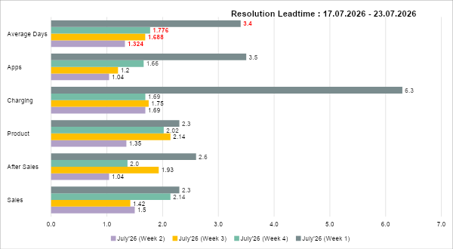
Customer Complaint (17 July – 23 July 2026) - Summary
3
Resolution Leadtime shows still below the 4 working days.
Current Average Resolution Leadtime: 2.05 Working Days
4th week of July' 26 Resolution Leadtime (Days)
Sales : 2.1
After Sales : 1.4
Product : 2.0
Charging : 1.7
Apps : 1.7
Total Average Days: 1.8

Slide 12
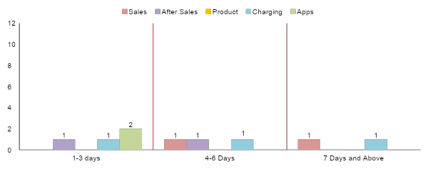
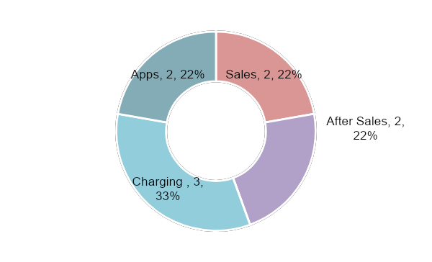
4
Customer Complaint: Total Outstanding Cases By Aging
Total Outstanding : 9 Cases
4 cases below 1-3 days, 3 cases below 4-6 days, 2 cases 7 days and above
Division
After Sales (1)
Service Operation (1)
Charging (1)
Home Charging (1)
Apps (2)
Profile (1)
Notification (1)
Sales (1)
Refund (1)
After Sales (1)
Body (1)
Charging (1)
Home Charging (1)
Sales (1)
Customer Experience (1)
Charging (1)
Home Charging (1)

Slide 13
Customer Complaint – Weekly 17 July – 23 July 2026
Customer Complaint – Weekly 17 July – 23 July 2026
Total Complaint: 9 [ After Sales (2) / Apps (2) / Charging (3) / Sales (2)]
Status: WIP: 9
No | Case ID | After Sales (2) | Status | Channel | Customer Info | Aging (Days) | Purchased Dealer | Remarks
1 | 200726-PROEV-35168 | Body | WIP | Phone Call | Name: Muhammad Amin Aizad Bin Ahmad Model: e.MAS7 Plate Num: CFH895 Chasis: PL1NKWEMRTG001838 | 4 | Proton e.MAS Rawang - Pantai Bharu Autohaus | Issue: Mudguard installation quality. Action Taken: Appointment with customer on 21/7 but customer still not satisfied on the mudguard adjustment. Next action: 27/7 - Pending next arrangement and advise by dealer.
2 | 230726-PROEV-35396 | Service Operation | WIP | Email | Name: Nur Imanina Binti Effendy Model: e.MAS5 Plate Num: EV254 Chasis: PL1BKNLMRTG000754 | 2 | Proton e.MAS Alor Setar - Rahmat Jutamas | Issue: Wheels alignment report. Action Taken: Escalate to dealer for further update advise on the Wheels Alignment Next action :27/2 - Await update from the dealer.

Slide 14
Customer Complaint – Weekly 17 July – 23 July 2026
Customer Complaint – Weekly 17 July – 23 July 2026
Total Complaint: 9 [ After Sales (2) / Apps (2) / Charging (3) / Sales (2)]
Status: WIP: 9
No | Case ID | Apps (2) | Status | Channel | Customer Info | Aging (Days) | Purchased Dealer | Remarks
1 | 210726-PROEV-35253 | Profile | WIP | Phone Call | Name: Muhammad Helmy Bin Mohammad Sabri Model: e.MAS7 Plate Num: RBE4678 Chasis: L6TE21SB2SY156955 | 4 | Proton e.MAS Glenmarie - EON | Issue: Unable to receive OTP Action Taken: Case escalated to PRO-NET Next action: 27/7 – Pending from Raphael to check.
2 | 230726-PROEV-35422 | Profile | WIP | WhatsApp | Name: Rukhairul Adli Bin Rusli Model: e.MAS5 Plate Num: JYV4700 Chasis: PL1BKNLMRTG000404 | 2 | Proton e.MAS Glenmarie - EON | Issue: Incorrect customer name displayed in the app Action Taken: Case escalated to dealer Next action: 27/7 - Dealer seek assistance from IT and will revert outcome.

Slide 15
Customer Complaint – Weekly 17 July – 23 July 2026
Customer Complaint – Weekly 17 July – 23 July 2026
Total Complaint: 9 [ After Sales (2) / Apps (2) / Charging (3) / Sales (2)]
Status: WIP: 9
No | Case ID | Charging (3) | Status | Channel | Customer Info | Aging (Days) | Purchased Dealer | Remarks
1 | 170726-PROEV-34969 | Home Charging | WIP | WhatsApp | Name: Nurul Ariffah Nadhira Binti Ghazali Model: e.MAS7 PHEV Plate Num: V2110MY Chasis: LB3P11SD7TH354370 | 8 | Proton e.MAS Kota Syahbandar - Xtream Auto | Issue: Home assessment fee refund as advised by dealer Action Taken: Customer ask for refund as he need to cancel and re-arrange at different location. SA promise can refund the assessment fee. Next action: 27/7- Awaiting dealer's response
2 | 200726-PROEV-35122 | Home Charging | WIP | WhatsApp | Name: Wong Teck Wai Model: e.MAS5 Plate Num: SPA1233 Chasis: LB3EH1SF3TX061155 | 5 | Proton e.MAS Cheras - Able Mobility | Issue: Manual home assessment for second wallbox Action Taken: Has assigned Installer for the home assessment - Energi Elite. Next action: 27/7 – Pending confirmation date and update.
3 | 210726-PROEV-35259 | Home Charging | WIP | Phone Call | Name: Razlan Adli Bin Zain Model: e.MAS5 Plate Num: SD8925Y Chasis: LB3EH1SF6SX003488 | 2 | Proton e.MAS Kuala Terengganu - IndahSari NEV | Issue: Wallbox power tripping Action Taken: Contractor has confirmed the appointment to conduct an on-site inspection. Next action: 27/7 - Await the contractor's findings and update following the full inspection.

Slide 16
Customer Complaint – Weekly 17 July – 23 July 2026
Customer Complaint – Weekly 17 July – 23 July 2026
Total Complaint: 9 [ After Sales (2) / Apps (2) / Charging (3) / Sales (2)]
Status: WIP: 9
No | Case ID | Sales (2) | Status | Channel | Customer Info | Aging (Days) | Purchased Dealer | Remarks
1 | 170726-PROEV-34921 | Customer Experience | WIP | Phone Call | Name: Noridayu Binti Yaakub Model: e.MAS7 PHEV Plate Num: N/A Chasis: N/A | 8 | Proton e.MAS Seremban - KKT New Energy | Issue: Unauthorized NCD transfer, vehicle registration, and booking cancellation request Action Taken: 27/7 – Dealer update that SA has oversight and miscommunication with Admin on the processing without consent by the customer. Management has decided to buyback the car. Next action: 27/7 – Pending further update on the completion of arrangement.
2 | 200726-PROEV-35154 | Refund | WIP | Email | Name: Tan Lek Boon Model: e.MAS5 Plate Num: N/A Chasis: N/A | 2 | Proton e.MAS Desa Park City, Kepong - Regal Motors | Issue: Refund delay Action Taken: Case has been escalated to dealer Next action: 27/7 - Await further update from dealer

